Slide 1
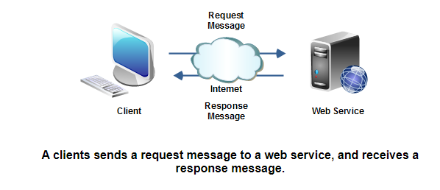
Web Service Message Formats
When a client and a web service communicate they exchange messages. A request message is sent from the client to the web service. The web service responds with a response message. This is just like in ordinary HTTP, where a web browser sends an HTTP request to a web server, and the web server replies with an HTTP response.
In the beginning the only web service message format available was SOAP. Later came REST type web services, which uses plain XML and HTTP. Following the REST movement came a wave of people using JSON (JavaScript Object Notation) as message format. Another very simple remoting protocol is called XML-RPC (XML Remote Procedure Call).

Slide 2
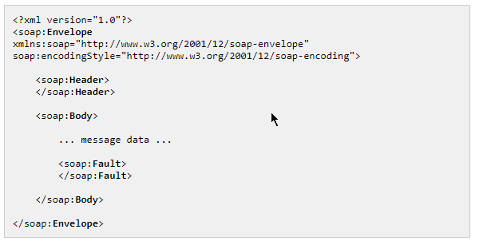
Web Service Message Formats
SOAP
SOAP (Simple Object Access Protocol) is an XML based message format.
Envelope
Header
Body
Message Data
Fault (optional)
The same SOAP message structure is used to send both requests and responses between client and web service.
The Fault element inside the Body element is optional. A Fault element is only sent back if an error occurs inside the web service. Otherwise the normal message data is sent back.

Slide 3
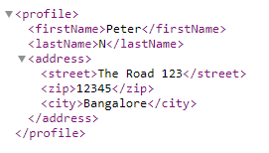
REST + XML
Web Service Message Formats
REST (REpresentational State Transfer) style web services work a bit different from SOAP web services. A REST request is a simple HTTP request just like a regular browser would send to a web server. There is typically no XML request sent. A REST response is typically an XML document sent back in a regular HTTP response, just as if a browser had requested it.
In REST you don't think so much in terms of "services", but rather in "resources". A resource has a given URL, just like an HTML page in a web site. An example of a resource could be a user profile in a social application. Such a resource could have the URL.
If you need to modify a resource in REST, you do so by sending different HTTP request to the server. When you read a resource you send an HTTP GET request. If you need to write a resource, you would send an HTTP PUT instead. If you need to delete a resource you would send an HTTP DELETE etc.
http://ram.com/profiles/peter

Slide 4
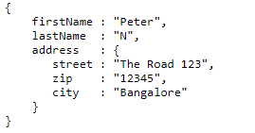
REST + JSON
Web Service Message Formats
REST + JSON is basically the same as REST + XML except that data is transfered in JSON (JavaScript Object Notation) instead of XML. The advantage of JSON over XML is that web browser are able to parse the JSON structures into JavaScript objects natively. You don't have to parse the JSON yourself in the browser then. That is much easier to work with in applications that use AJAX a lot.
http://ram.com/profiles/peter

Slide 5
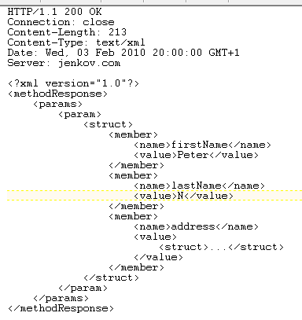
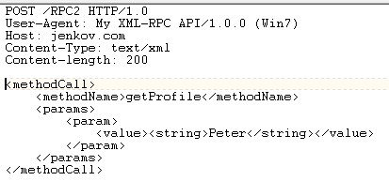
XML RPC
Web Service Message Formats
XML RPC is closer to SOAP than it is to REST. XML RPC has both a request and a response format. XML RPC is a somewhat simpler protocol than SOAP is. It is also closer modeled to a regular procedure call. Some people claim that XML RPC is now dead or obsolete.
XML RPC response example
XML RPC request example

